Slide 1


WaveWatch – machine learning & wave analysis
Presenting: Lior Zucker Eyal Cohen
Supervisor : Dr. Reuven Cohen
1

Slide 2

WaveWatch
Table of contents
Introduction
▼
Existing tools
▼
Problem
▼
parameters
▼
Solution
▼
Process
▼
YOLO
▼
Data Gathering And Annotation
▼
Research
▼
product
▼
Testing plan
▼
Expected Achievements
▼
Conclusions
Introduction
Existing tools
Problem
parameters
Solution
Process
YOLO
Data Gathering And Annotation
Research
product
Testing plan
Expected Achievements
Conclusions
By Eyal Cohen
& Lior Zucker

Slide 3
WaveWatch
The problem
Introduction
▼
Existing tools
▼
Problem
▼
parameters
▼
Solution
▼
Process
▼
YOLO
▼
Data Gathering And Annotation
▼
Research
▼
product
▼
Testing plan
▼
Expected Achievements
▼
Conclusions
Introduction
Current Situation: Surfers face significant challenges in predicting wave conditions due to the limitations of manual observation.
Existing tools:
Need for the Project: There's a need for an automated tool that can analyze sea conditions accurately, providing surfers with data for better decision-making.
Project Objectives: WaveWatch aims to provide surfers with insights on wave conditions using machine learning to analyze beach video footage.
beach cameras
wave forecasts
weather forecasts
By Eyal Cohen
& Lior Zucker

Slide 4
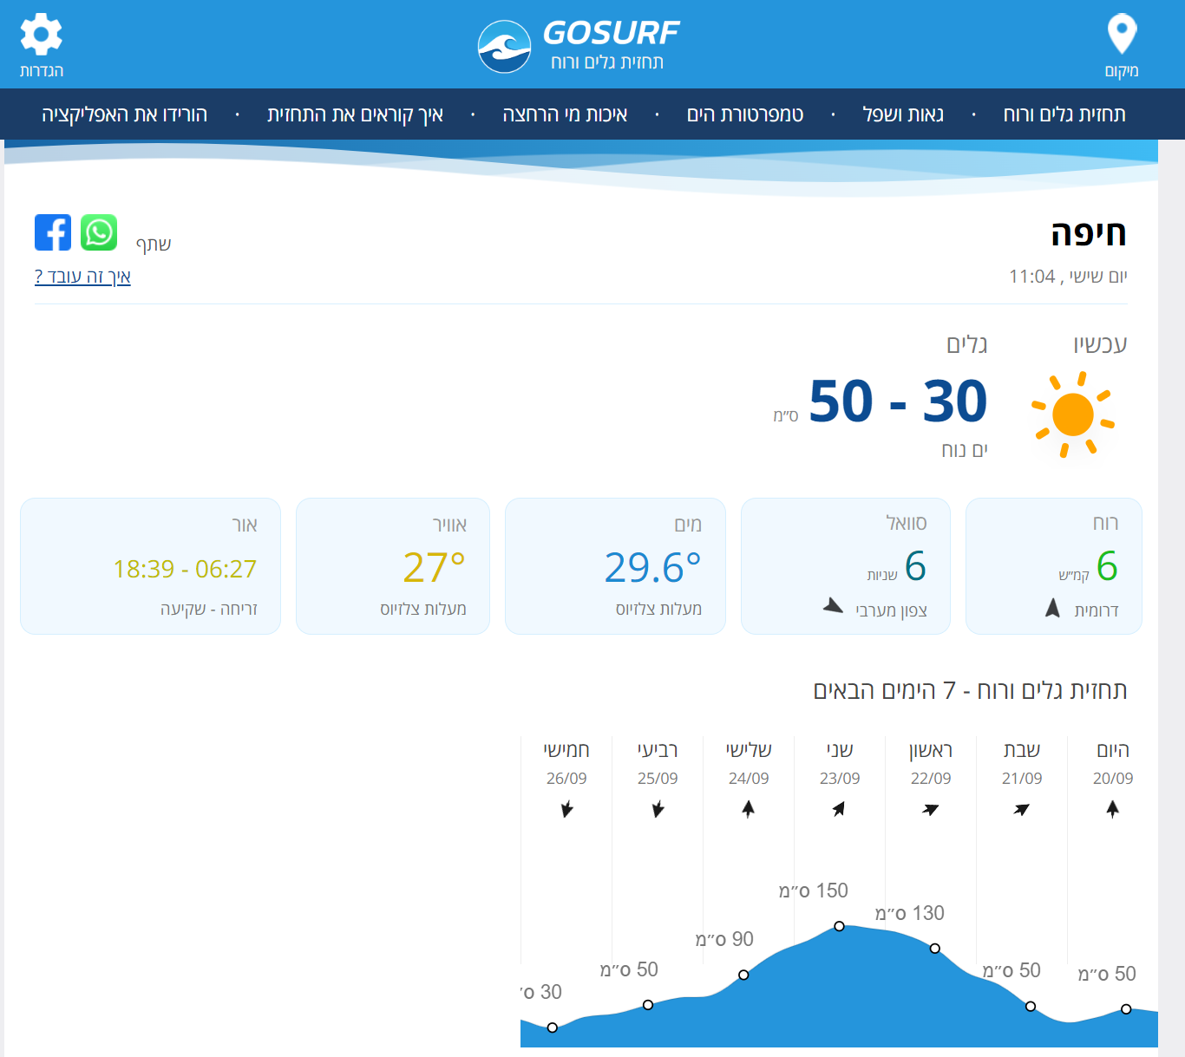
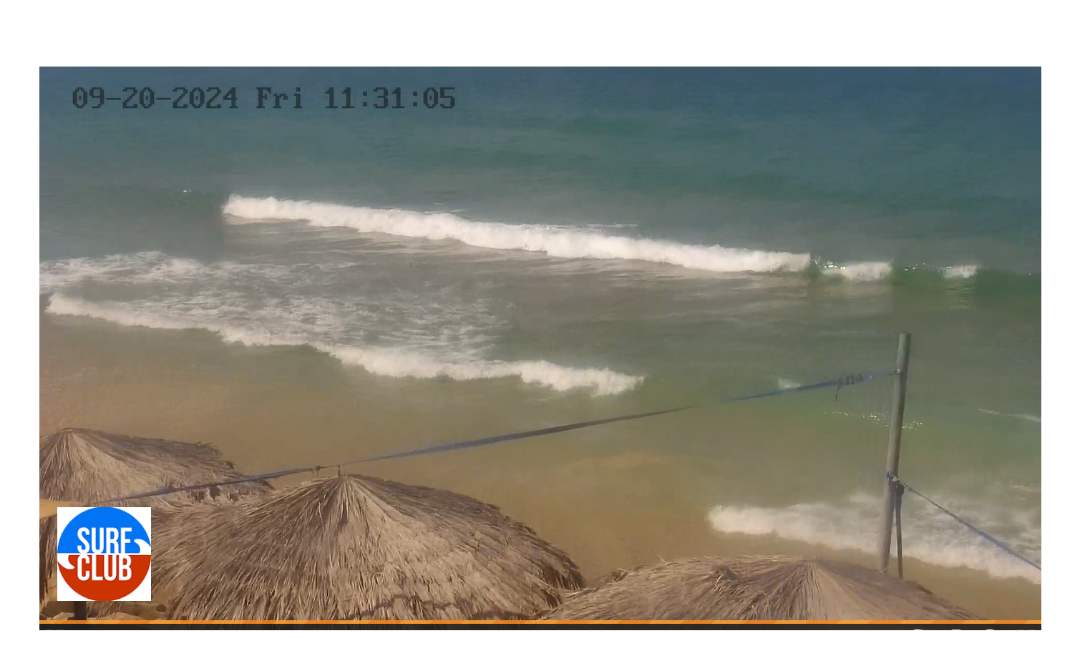
WaveWatch
Existing tools
Introduction
▼
Existing tools
▼
Problem
▼
parameters
▼
Solution
▼
Process
▼
YOLO
▼
Data Gathering And Annotation
▼
Research
▼
product
▼
Testing plan
▼
Expected Achievements
▼
Conclusions
beach cameras
wave forecasts
weather forecasts
By Eyal Cohen
& Lior Zucker

Slide 5
WaveWatch
Problem
Introduction
▼
Existing tools
▼
Problem
▼
parameters
▼
Solution
▼
Process
▼
YOLO
▼
Data Gathering And Annotation
▼
Research
▼
product
▼
Testing plan
▼
Expected Achievements
▼
Conclusions
Problem Definition: Current surf forecasting methods require manual interpretation.
Surfing enthusiasts often struggle to accurately predict when conditions are optimal for catching waves.
Factors such as swell period, wave duration, crowd density and wave count per swell duration .
By Eyal Cohen
& Lior Zucker

Slide 6
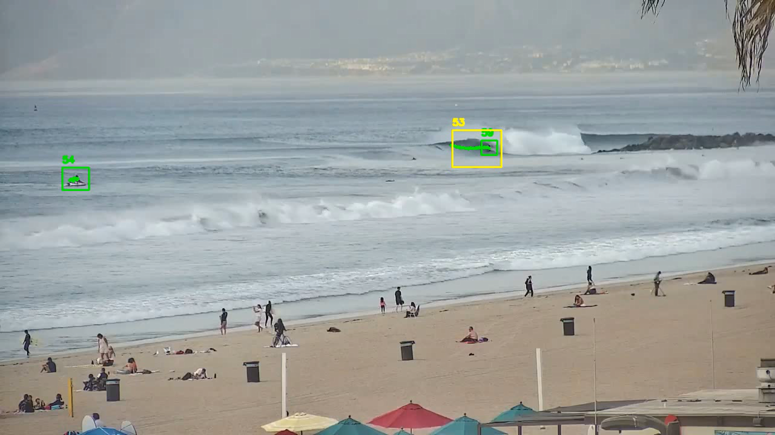
WaveWatch
Parameters
Introduction
▼
Existing tools
▼
Problem
▼
parameters
▼
Solution
▼
Process
▼
YOLO
▼
Data Gathering And Annotation
▼
Research
▼
product
▼
Testing plan
▼
Expected Achievements
▼
Conclusions
swell period: It specifically indicates the length of time over which multiple waves occur.
wave duration: Is the amount of time a wave lasts from the moment it begins to break until it fully disappears.
crowd density: The number of surfers in the water
wave count per swell duration: Is the number of waves that occur during a single swell period
By Eyal Cohen
& Lior Zucker

Slide 7
WaveWatch
Solution
Introduction
▼
Existing tools
▼
Problem
▼
parameters
▼
Solution
▼
Process
▼
YOLO
▼
Data Gathering And Annotation
▼
Research
▼
product
▼
Testing plan
▼
Expected Achievements
▼
Conclusions
Proposed Solution: WaveWatch solves this by automating the analysis of beach videos through machine learning, focusing on key parameters.
Project Goals: Improve safety and surfing experience.
By Eyal Cohen
& Lior Zucker

Slide 8
WaveWatch
Process- Challenges
Introduction
▼
Existing tools
▼
Problem
▼
parameters
▼
Solution
▼
Process
▼
YOLO
▼
Data Gathering And Annotation
▼
Research
▼
product
▼
Testing plan
▼
Expected Achievements
▼
Conclusions
Accuracy: how accurate the model will detect waves and surfers.
Light conditions: different light condition can affect the accuracy of the model , therefore the data set should include a variety of conditions.
Camera Angles: live streams of beach cameras often deliver different type of camera angles, therefore the data set should include a variety of angles.
Weathers: the beach and the waves are affected by the weather, therefore the data set should include a variety of weathers.
By Eyal Cohen
& Lior Zucker

Slide 9

WaveWatch
Model Training -YOLO
Introduction
▼
Existing tools
▼
Problem
▼
parameters
▼
Solution
▼
Process
▼
YOLO
▼
Data Gathering And Annotation
▼
Research
▼
product
▼
Testing plan
▼
Expected Achievements
▼
Conclusions
YOLO is an object detection algorithm known for its speed and accuracy.
Real-Time Object Detection: YOLO processes images in a single pass, enabling it to detect objects in real time with high speed and efficiency.
High Accuracy with Fewer Errors: YOLO is known for its balance of speed and accuracy, reducing background errors and producing fewer false positives.
By Eyal Cohen
& Lior Zucker

Slide 10
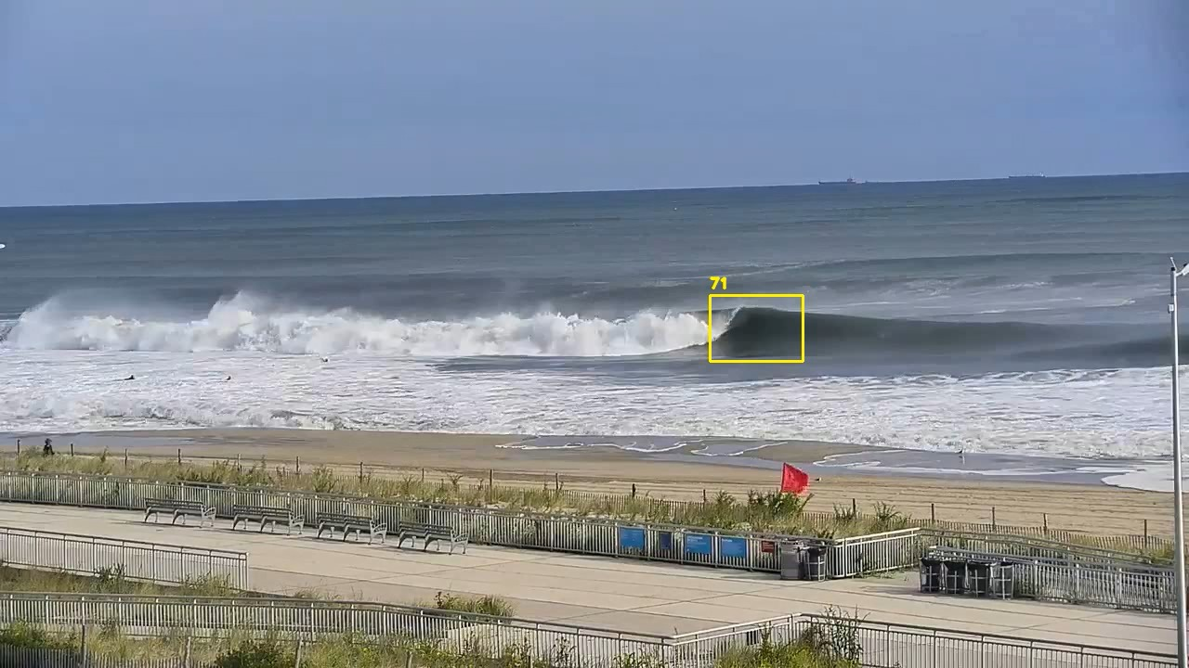
WaveWatch
Data Gathering And Annotation
Introduction
▼
Existing tools
▼
Problem
▼
parameters
▼
Solution
▼
Process
▼
YOLO
▼
Data Gathering And Annotation
▼
Research
▼
product
▼
Testing plan
▼
Expected Achievements
▼
Conclusions
Development starts with data collection from beach camera, capturing various conditions (wave and weather conditions).
For example we wrote an automated script that extracts multiple frames from various beach cameras from Israel.
Annotate videos by labelling key objects like waves and surfers.
These annotations are crucial for building a strong dataset to train the YOLO model.
The accuracy of the annotations will directly impact the model's performance.
By Eyal Cohen
& Lior Zucker

Slide 11
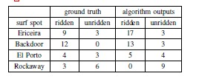
WaveWatch
Research
Introduction
▼
Existing tools
▼
Problem
▼
parameters
▼
Solution
▼
Process
▼
YOLO
▼
Data Gathering And Annotation
▼
Research
▼
product
▼
Testing plan
▼
Expected Achievements
▼
Conclusions
Studied academic papers on beach monitoring and wave analysis to understand the background.
For example a similar project at the Technion, focused mainly on the number of surfers in the water and whether they were surfing in the image or not.
Our approach, however, emphasizes the parameters we have discussed here.
By Eyal Cohen
& Lior Zucker

Slide 12
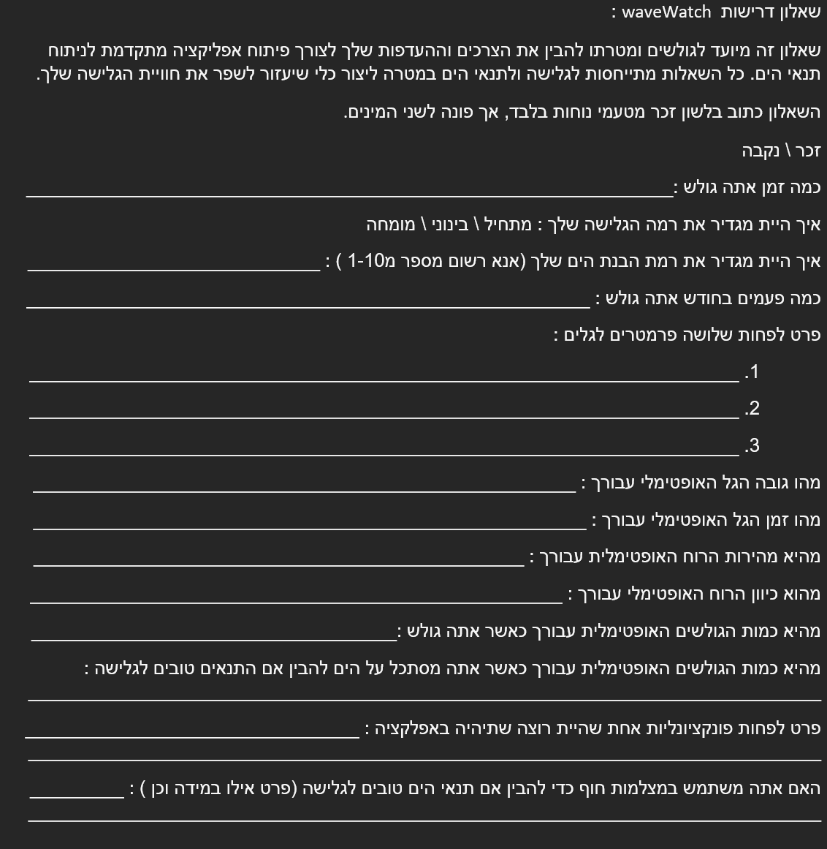
WaveWatch
Research- questionnaire
Introduction
▼
Existing tools
▼
Problem
▼
parameters
▼
Solution
▼
Process
▼
YOLO
▼
Data Gathering And Annotation
▼
Research
▼
product
▼
Testing plan
▼
Expected Achievements
▼
Conclusions
Conducted a questionnaire with local surfing groups to gather feedback on desired app features and analysis parameters.
Used community insights to guide app functionality and parameter selection.
By Eyal Cohen
& Lior Zucker
Notes:
later.

Slide 13
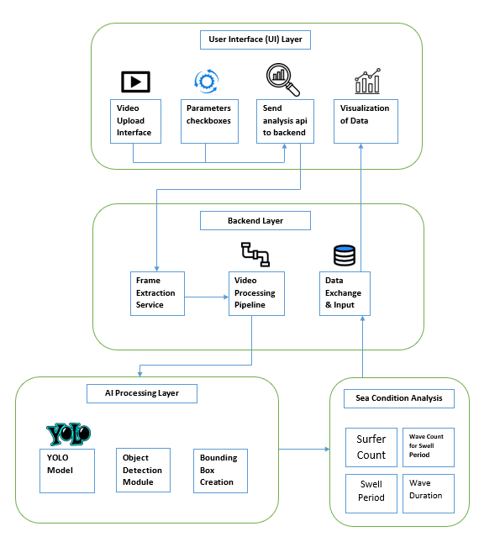
WaveWatch
Product
Introduction
▼
Existing tools
▼
Problem
▼
parameters
▼
Solution
▼
Process
▼
YOLO
▼
Data Gathering And Annotation
▼
Research
▼
product
▼
Testing plan
▼
Expected Achievements
▼
Conclusions
User uploads video and selects analysis parameters in the UI.
Backend extracts frames and processes video data.
YOLO model detects surfers and waves, creating bounding boxes.
Sea conditions like surfer count and wave duration are analysed and visualized.
By Eyal Cohen
& Lior Zucker

Slide 14
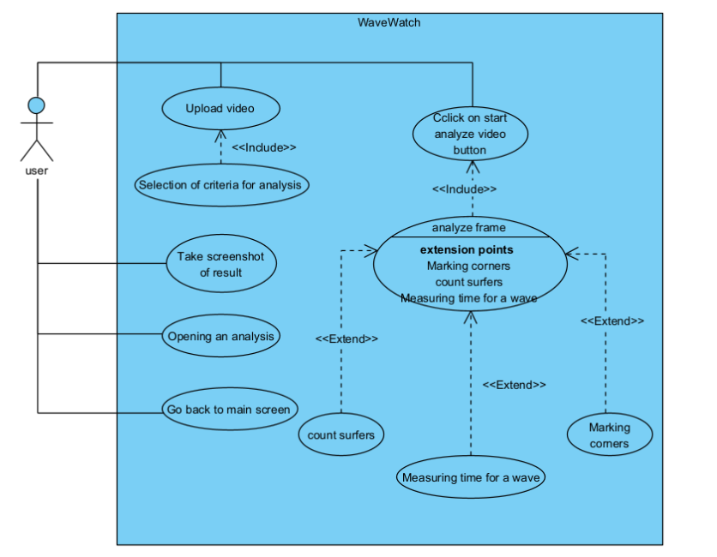
WaveWatch
Product-usecase
Introduction
▼
Existing tools
▼
Problem
▼
parameters
▼
Solution
▼
Process
▼
YOLO
▼
Data Gathering And Annotation
▼
Research
▼
product
▼
Testing plan
▼
Expected Achievements
▼
Conclusions
Upload video: The user uploads a video for analysis.
Select criteria for analysis: The user picks parameters for the video analysis.
Start analysis: The user clicks a button to begin analysing the video, which includes extensions like counting surfers, marking corners, and measuring wave time.
View results: The user can take a screenshot of the results, and return to the main screen for another analyses.
By Eyal Cohen
& Lior Zucker

Slide 15
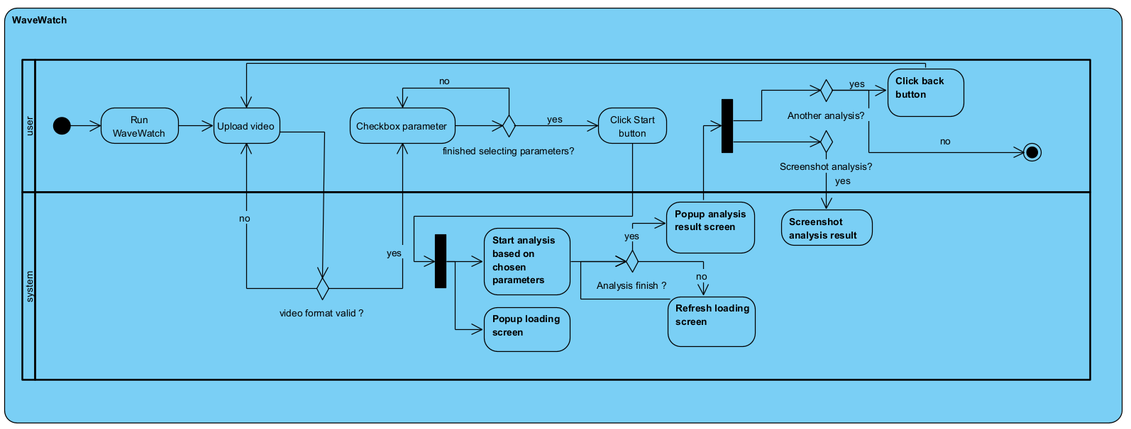
WaveWatch
Product-activity
Introduction
▼
Existing tools
▼
Problem
▼
parameters
▼
Solution
▼
Process
▼
YOLO
▼
Data Gathering And Annotation
▼
Research
▼
product
▼
Testing plan
▼
Expected Achievements
▼
Conclusions
By Eyal Cohen
& Lior Zucker

Slide 16
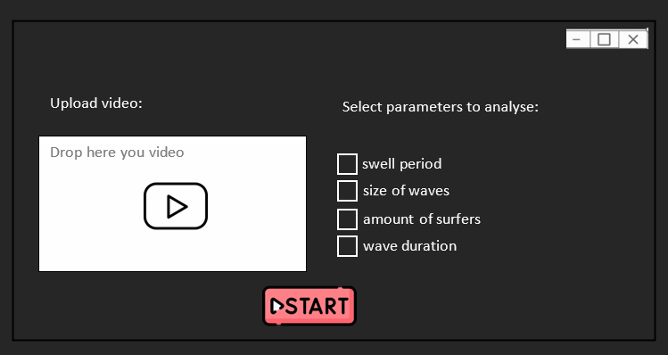
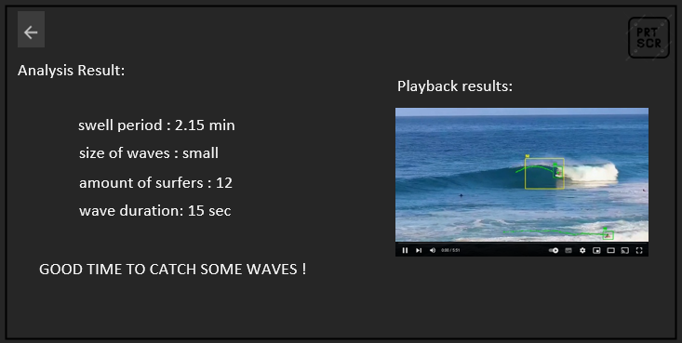
WaveWatch
Product-prototype
Introduction
▼
Existing tools
▼
Problem
▼
parameters
▼
Solution
▼
Process
▼
YOLO
▼
Data Gathering And Annotation
▼
Research
▼
product
▼
Testing plan
▼
Expected Achievements
▼
Conclusions
First screen: allows users to upload videos and select parameters for analysis.
second screen: presents the annotated results and metrics, with options to save or return to the dashboard.
By Eyal Cohen
& Lior Zucker

Slide 17
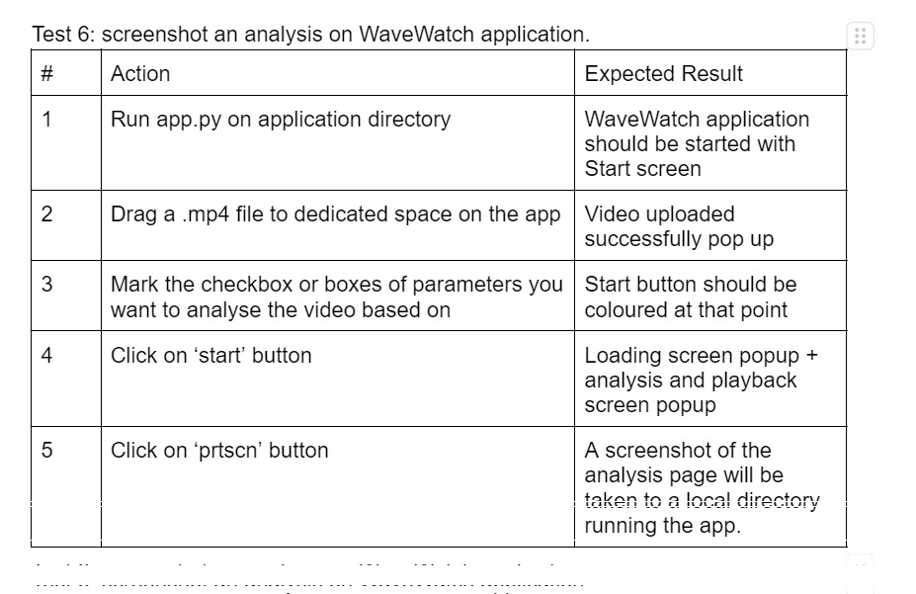
WaveWatch
Testing plan
Introduction
▼
Existing tools
▼
Problem
▼
parameters
▼
Solution
▼
Process
▼
YOLO
▼
Data Gathering And Annotation
▼
Research
▼
product
▼
Testing plan
▼
Expected Achievements
▼
Conclusions
Functional Testing: Verify key features using manual testing and automated scripts.
By Eyal Cohen
& Lior Zucker

Slide 18
WaveWatch
Expected Achievements
Introduction
▼
Existing tools
▼
Problem
▼
parameters
▼
Solution
▼
Process
▼
YOLO
▼
Data Gathering And Annotation
▼
Research
▼
product
▼
Testing plan
▼
Expected Achievements
▼
Conclusions
AI-Driven Analysis: Delivers fast, accurate wave and sea condition insights.
User-Friendly Interface: Simplifies complex evaluations for all skill levels.
Versatile Applications: Optimizes surf sessions, ensures safety, and enhances all type of beach goers.
By Eyal Cohen
& Lior Zucker

Slide 19
WaveWatch
Conclusions
Introduction
▼
Existing tools
▼
Problem
▼
parameters
▼
Solution
▼
Process
▼
YOLO
▼
Data Gathering And Annotation
▼
Research
▼
product
▼
Testing plan
▼
Expected Achievements
▼
Conclusions
Our solution for Surf Enthusiasts, WaveWatch provides a user-friendly tool to monitor and analyze beach conditions.
Comprehensive Video Analysis By utilizing YOLO architecture.
Research-Driven Development built on background, literature review and feedback from the local surfing community.
Model Training: The model will be trained using annotated beach video data, focusing on key surfing parameters.
WaveWatch aims to deliver precise real-time insights on wave patterns, crowd dynamics, and environmental conditions, significantly improving decision-making for surfers and beachgoers.
By Eyal Cohen
& Lior Zucker

Slide 20

Thank you for listening.
Q&A ☺
17

